Slide 1
Community Climate Forum
14th April 2025

Slide 2
Welcome!
Welcome
YTC on Climate Change
Frogmore Orchard Project
Refreshments
General discussion and feedback
To our first Community Climate Forum

Slide 3
YTC Climate Overview
Town Plan 2024 Priorities Summary
Improving YTC Buildings
Solar Panels
Future Plans
Carbon Handprint

Slide 4

Climate Priorities Summary
Net Zero by 2030
Council decisions meet climate change criteria
Reduce single use plastics
Support biodiversity and continue to plant trees
Improve energy efficiency of our buildings

Slide 5
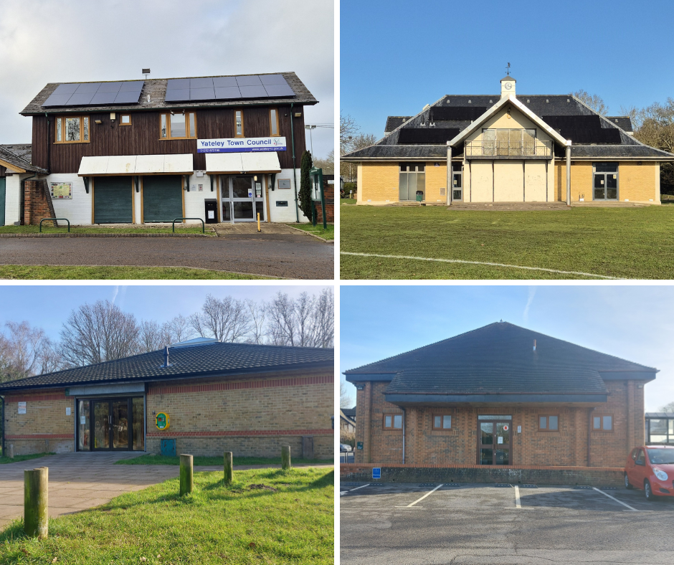
Our Buildings
Our buildings include:
  Office at Yateley Green
  The Tythings- hall for hire with youth suite downstairs
  Darby Green Centre- hall for hire
  Monteagle Community Centre- hall and small upstairs room
  Orchard Hall- long-term lease
  Yateley Village Hall- long-term lease, maintenance carried out by leaseholder
  Yateley Bowling Club- long-term lease

Slide 6
Improvements to Buildings
Possible improvements to buildings to reduce their carbon footprint include:
  Increasing insulation
  Replacing old windows
  Replacing lights with LEDs
  Replacing old boiler with heat pump
  Replacing old electric heaters with WiFi infrared
  Adding solar panels
  Installing electric car chargers
And we try to make things as efficient as possible in our office!
Done!
In progress
Done!
Waiting until they need replacing, using Hive in Tythings
In progress
Done at our office and the Tythings! In progress for our other buildings
Looking at costs and practicality

Slide 7
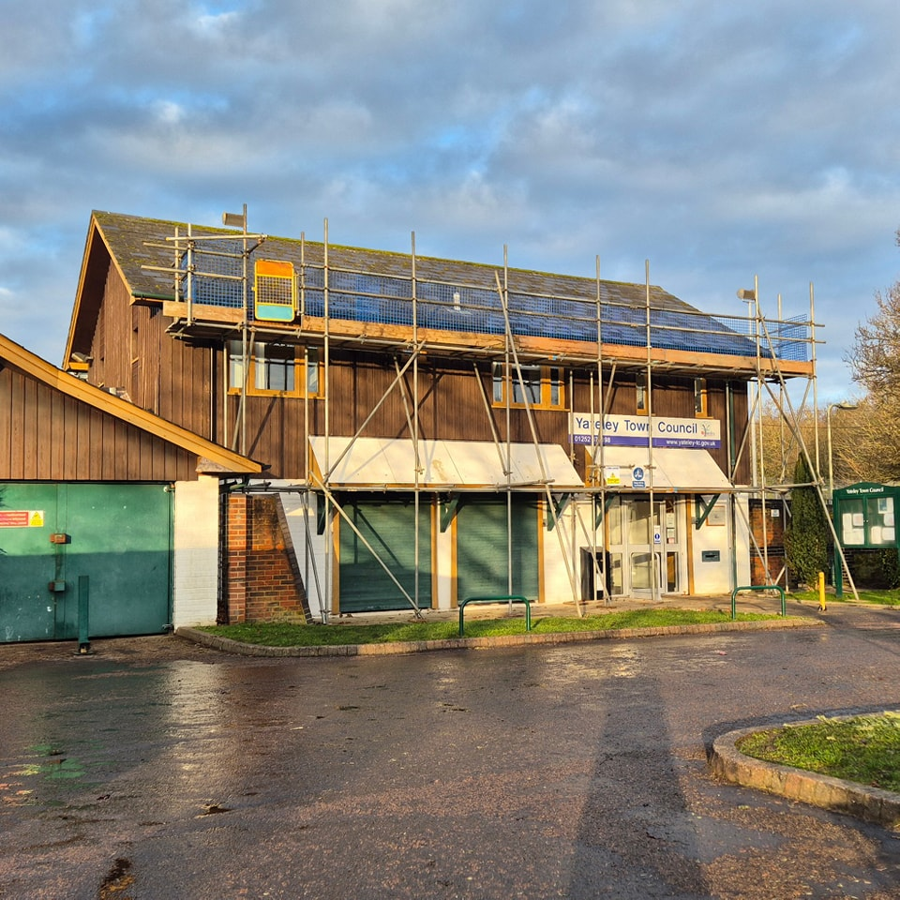
Solar Panels
Conservation area so needed to apply for Planning Permission
Successfully applied for grant from HCC
  Grant covered the cost of the panels and installation
Panels installed on our office in January and Tythings in February
  Office has 8.10 kWp with annual output of around 6,836 kWh
  Tythings has 6.077 kWp with annual output of around 5,129 kWh
Total time around 2.5-3 years

Slide 8
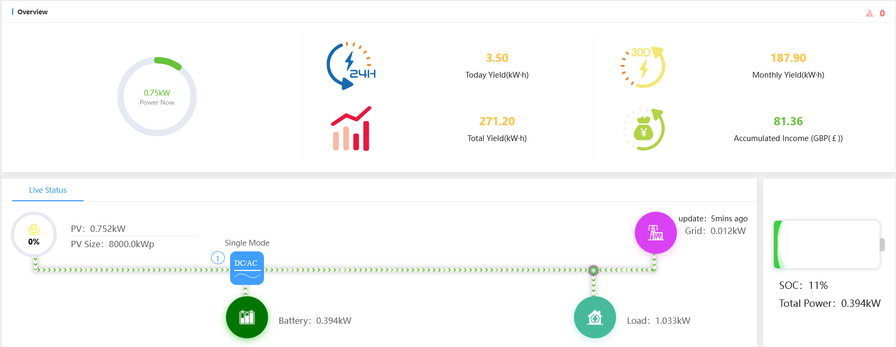
Solar Panels- Live Data

Slide 9
Solar Panel Data So Far…

Slide 10
Solar Panel Data So Far…

Slide 11
Future Plans
Solar panels on other buildings
Darby Green needs planning and we need to ensure they cannot be vandalised
Monteagle is a great prospect as all electric heating
Assessing suitability for our leased buildings
Moving away from gas heating
Infrared heating in Monteagle
Heat pumps in other buildings when boilers need replacing
Electric vehicles
Electric van for travelling the parish
Assessing electric car chargers in our car parks

Slide 12
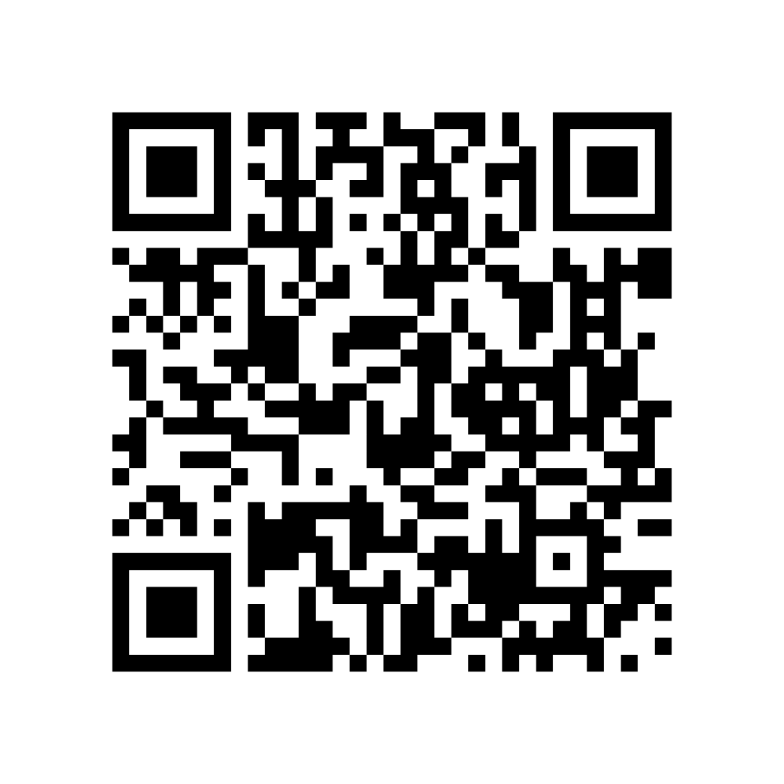
Carbon Handprint
Carbon Literacy
  Three Officers are Certified Carbon Literate
  We will be providing courses!
  Fill out the survey by going to
  https://yateley-tc.gov.uk/news/carbon-literacy-course-survey/
Climate Change Café
  Informal chat about climate change in a café in Yateley
  Probably once a month
How we are helping to increase Climate Change awareness

Slide 13

Carbon Handprint
A short video

Slide 14

Thank you for listening!
Any questions?

Slide 15
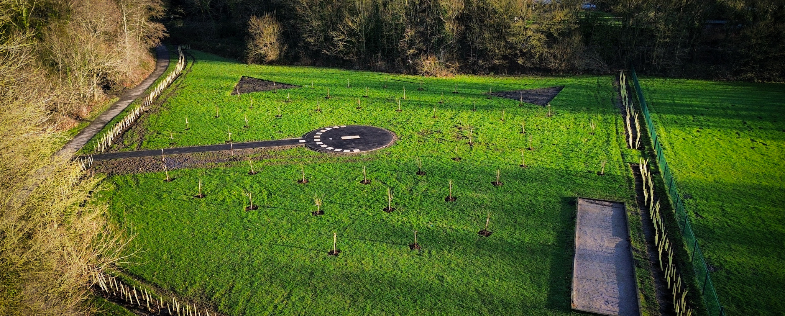
Frogmore Orchard
Presenter: Alex Drage

Slide 16
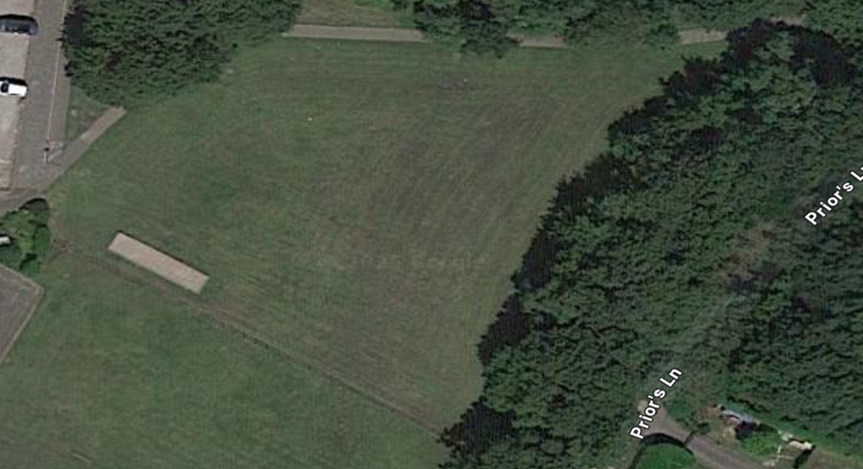
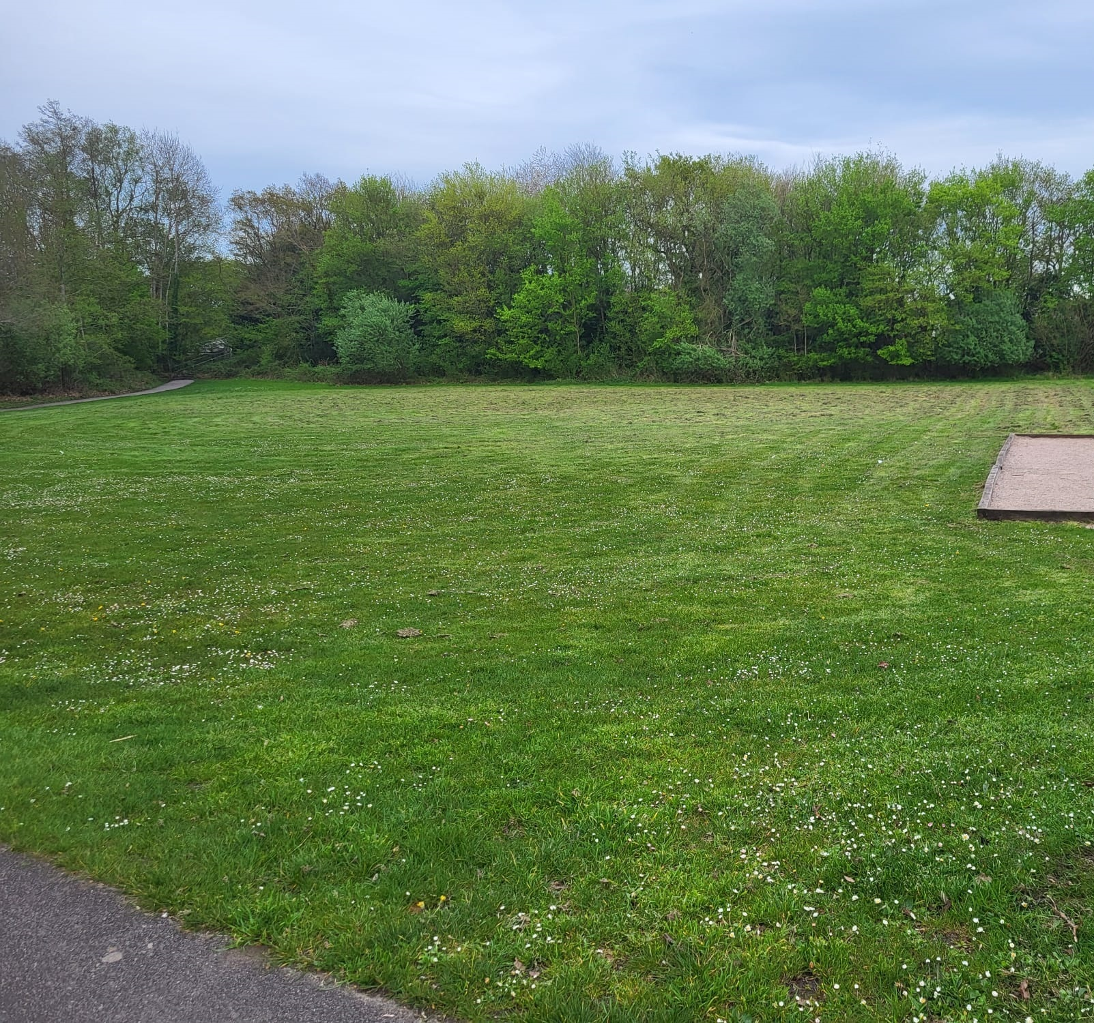
Our Purpose:
As a community campus, we want to utilise one of the empty fields on the campus to turn into a community orchard/green space.
Frogmore Community Orchard - Start
Our Goals:
To create an orchard/green space which will:
Create a living reminder celebrating the 50th anniversary of the campus.
An open space for the users of the campus and the wider community.
Create an area of habitat biodiversity and bring a wildlife haven to the campus.
Date Oct 2023

Slide 17

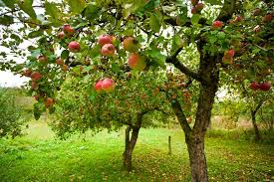
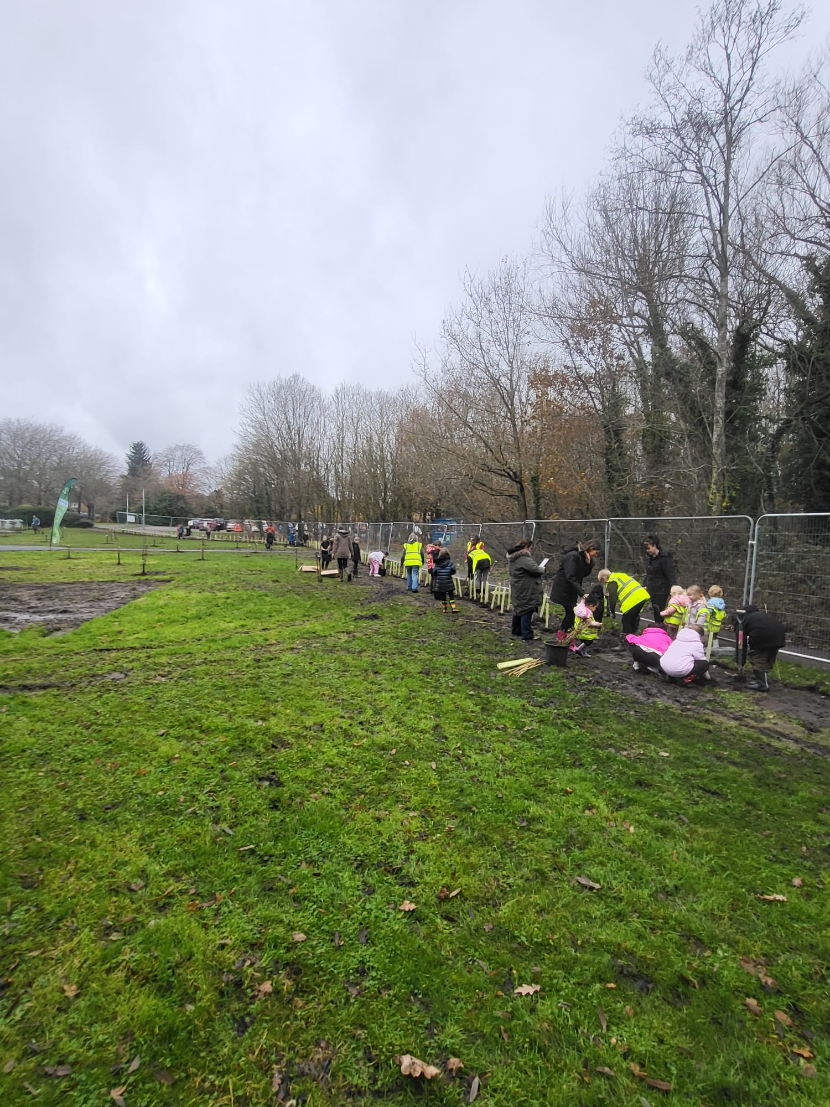
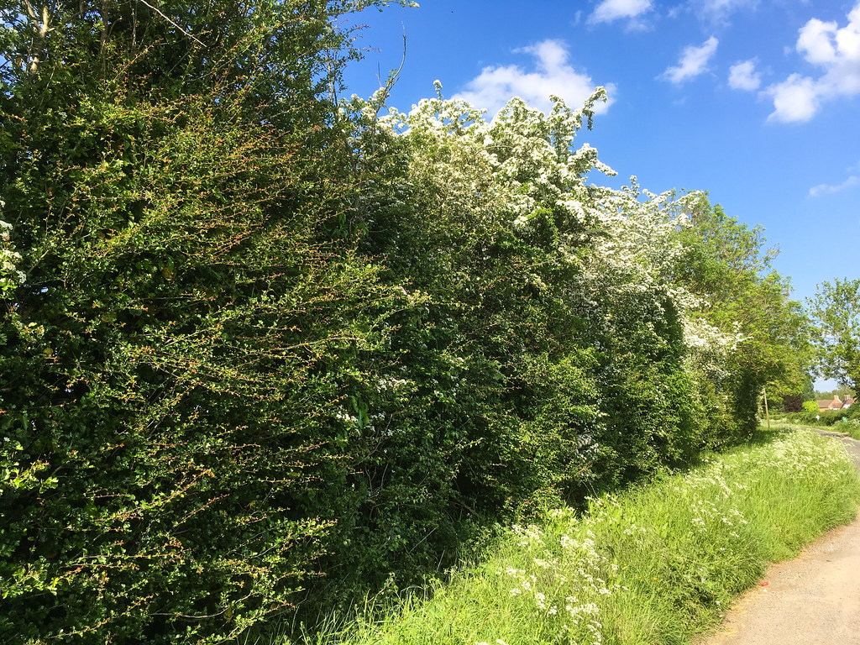
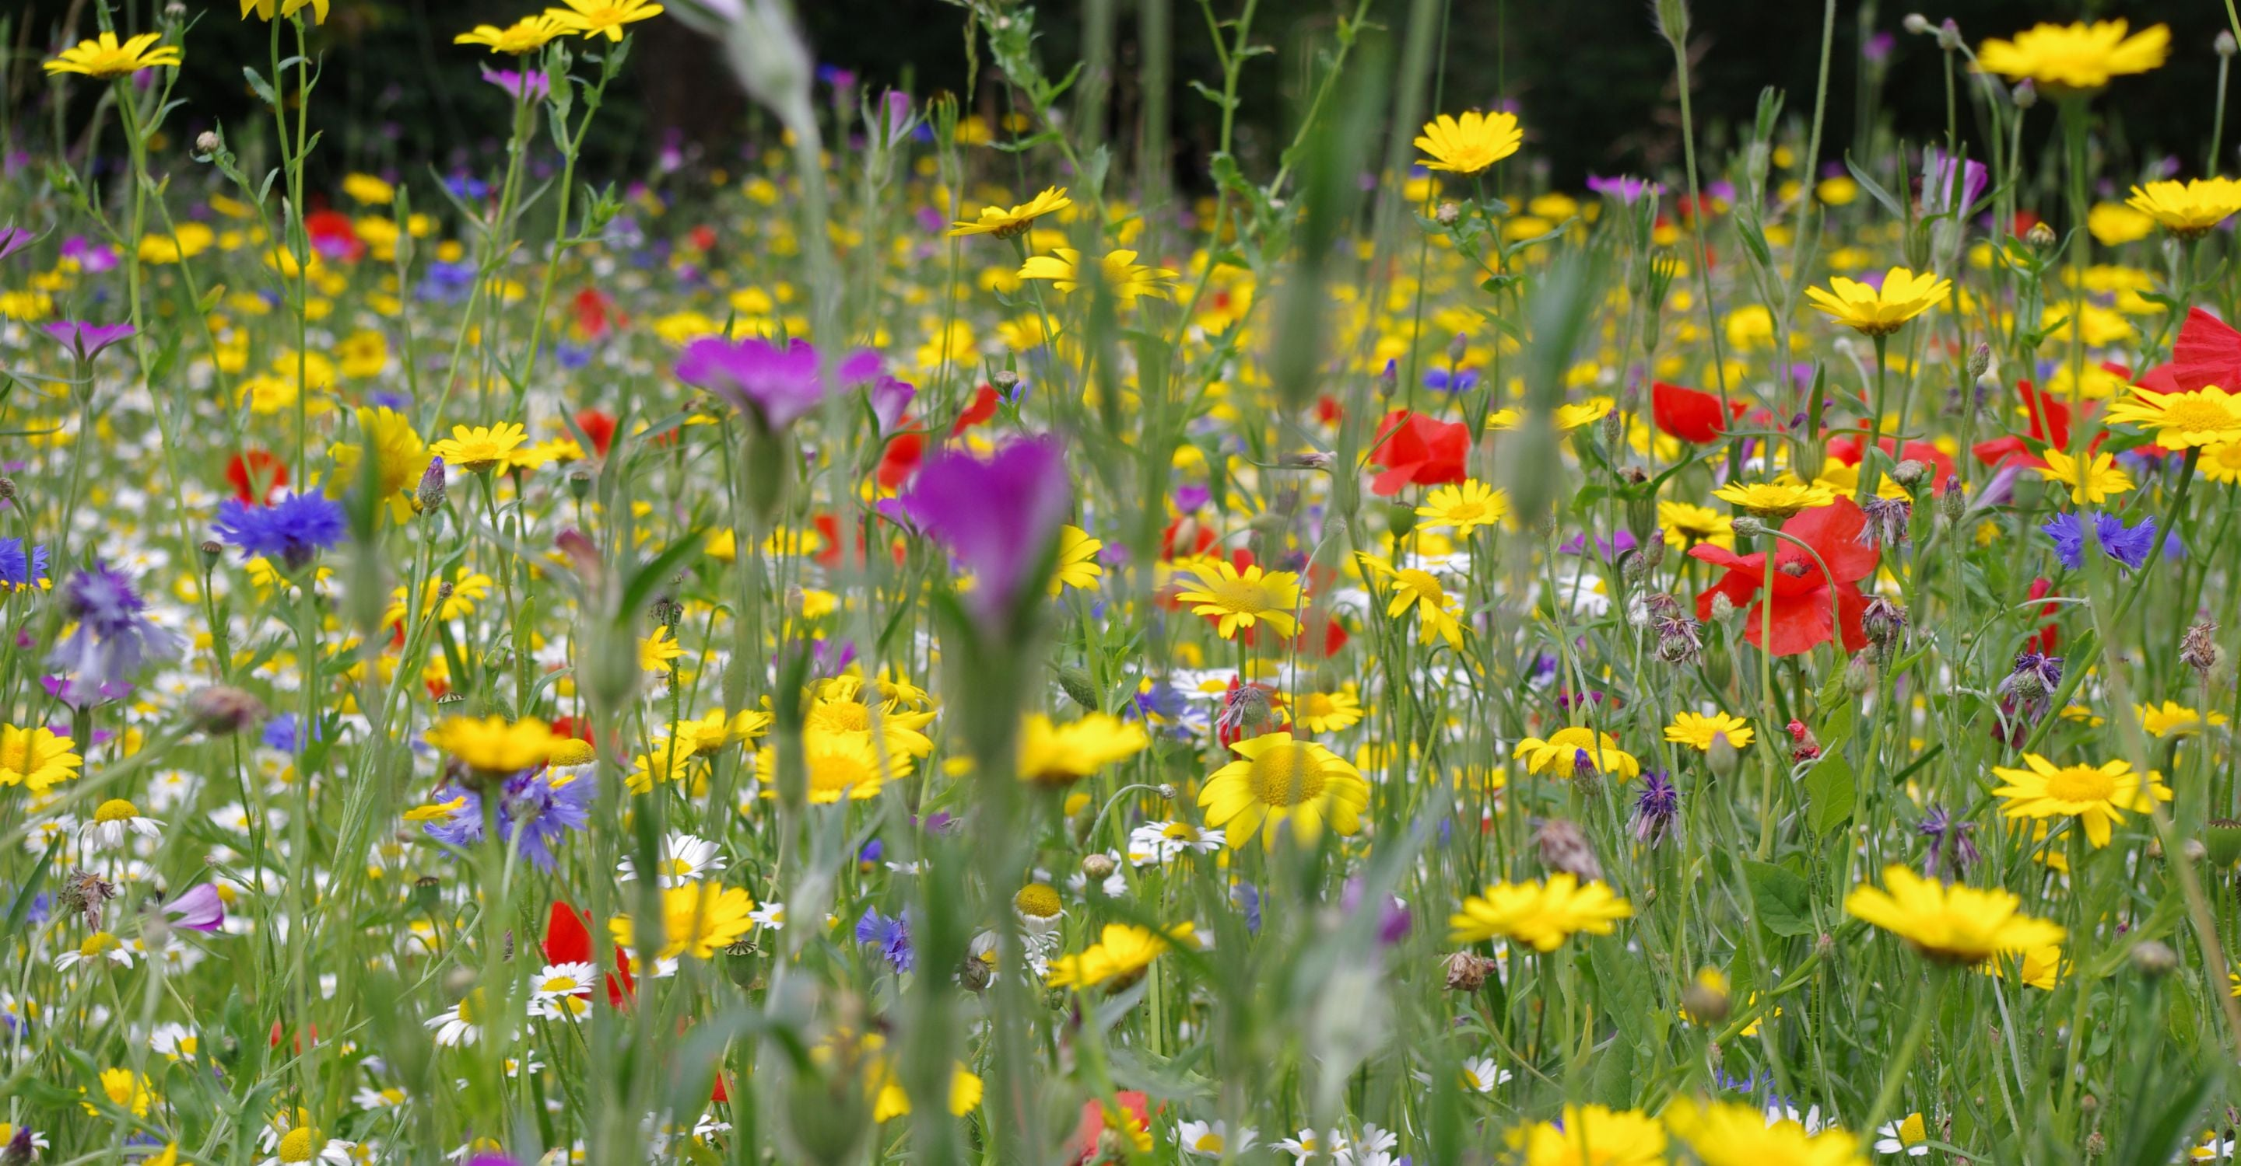
Biodiversity
To create and encourage habitat biodiversity on our campus.
All donated as part of HCC’s Million Tree Challenge.
In Nov 2024 we had a planting day.
Over 250 kids got to plant at least 1 tree.
Thanks to Foremost, Yateley Society for their support on the day.
50 (ish) fruit trees including apple, pear, plum and cherry.
160 meters of British native hedgerow.
150 meters² of wildflower areas.
Headlines

Slide 18

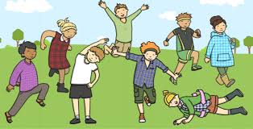
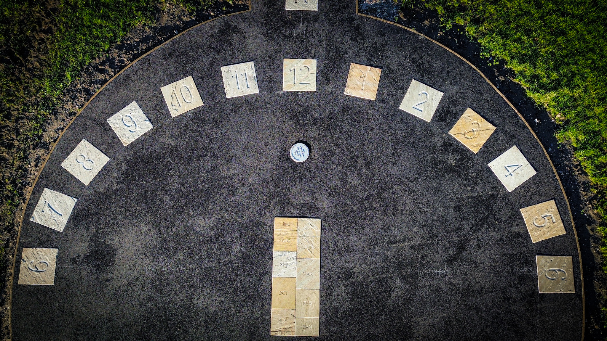
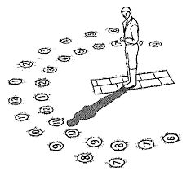
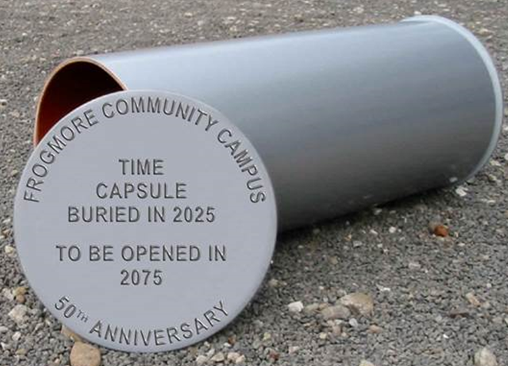
Education
To educate and inspire young (and not so young) minds.
Space designed for max learning by I’m Adam Design.
All groundwork done by M Group and BQS.
Path/Circle done in Oct and stonework done in Dec 2024.
Includes an info board.
An open space for outside learning.
A ‘human’ sundial.
A time capsule to be opened in 2075.
Headlines

Slide 19


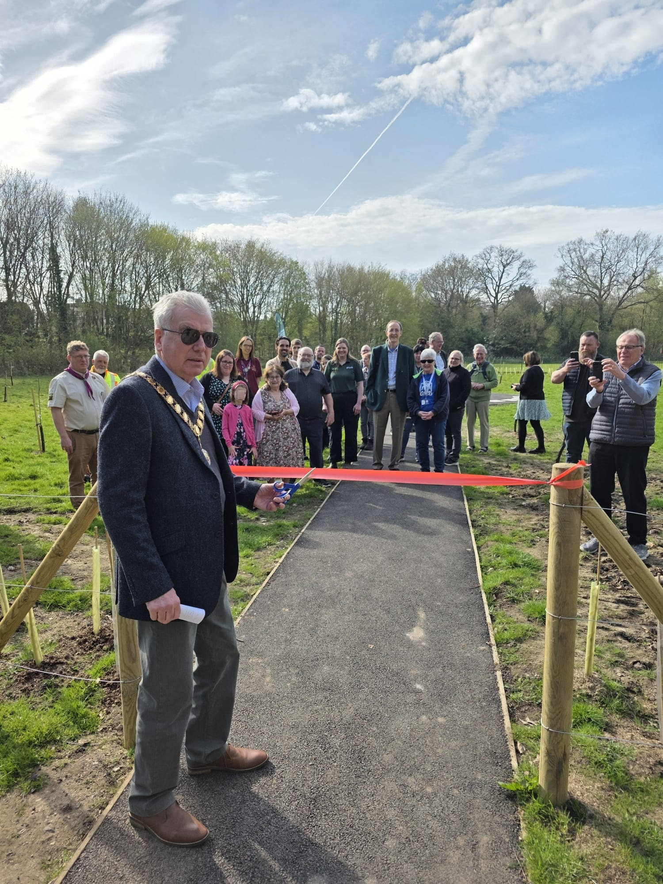
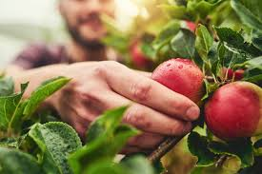
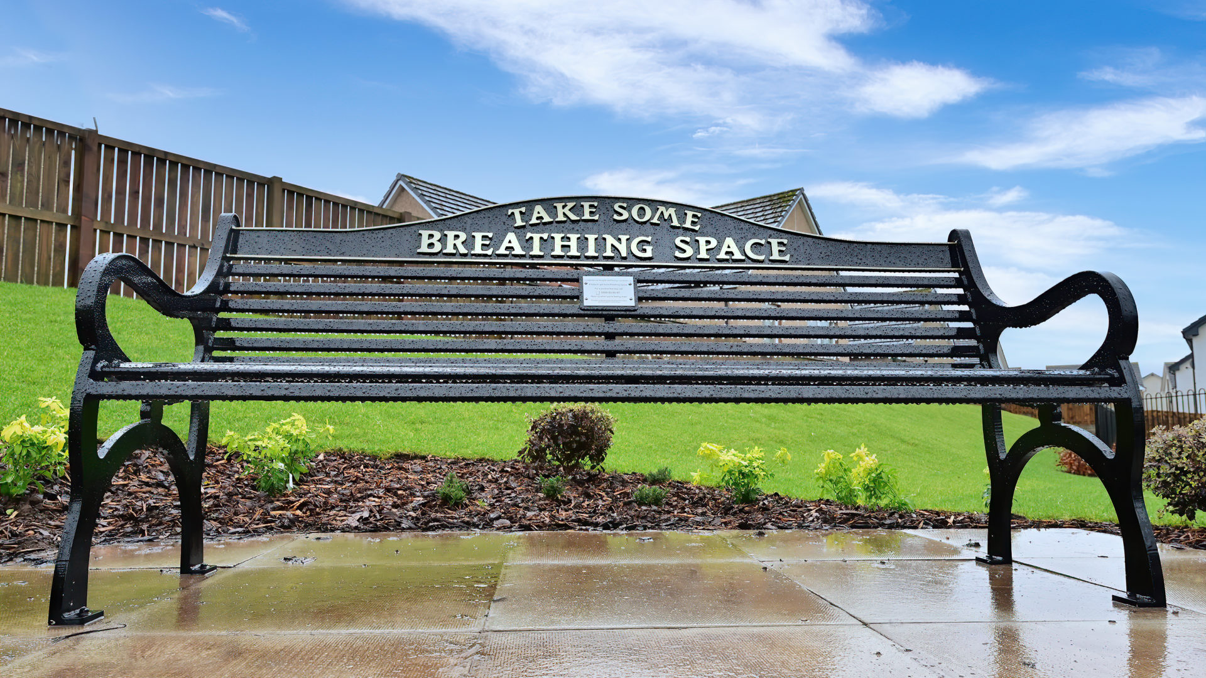
Community & celebration
To celebrate the campus and the benefit it brings to the community.
A living, breathing centre piece for the celebration.
Sponsor a tree scheme setup for anyone in the community.
Referb of the Pétanque pitch for U3A and others.
Getting multiple community orgs involved in the creation.
Helping towards the town environmental goals.
Celebrating the 50th anniversary of the campus.
Open to the community for fruit picking.
A space for peace and quiet for people and nature.
Headlines

Slide 20

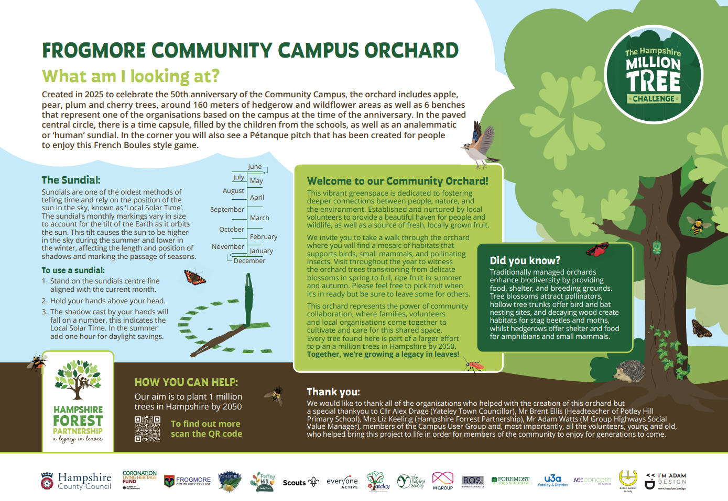
Further info and thanks
A special thanks to all the organisations involved in making this happen.
Hampshire CC.
Hampshire CC Forest Partnership.
Potley Hill Primary School.
Potley Hill Early Years Pre-School.
Frogmore College (including the student leaders).
The Scouts.
Everyone Active Gym.
Yateley Town Council.
The Yateley Society.
M Group.
BQS.
Foremost Tree Surgeons.
U3A.
British Sundial Society.
I’m Adam design.

Slide 21

Finances
The cold hard numbers.
Description | Cost (Approx)
Fruit Trees | £2500
Hedgerow whips | £1400
Grass stripping (plant hire) | £500
Wildflower seed | £80
Path and central circle | £5000
Sundial Calculations | £30
Fencing | £2000
Info Board | £330
Pétanque pitch referb | £750
Design | £3000
Time Capsule | £324
*Benches | £3000
*Water system | £500
Cost to project | Type | Notes
£0 | MTC Scheme | Provided by Hampshire forest partnership
£0 | MTC Scheme | Provided by Hampshire forest partnership
£0 | Community outreach | BQS volunteered all time and materials managed by M Group
£0 | MTC Scheme | Provided by Hampshire forest partnership
£0 | Community outreach | BQS volunteered all time and materials managed by M Group
£0 | Volunteer time | British Sundial Society gave us the calculations
£0 | MTC Scheme | Provided by Hampshire forest partnership
£0 | MTC Scheme | Provided by Hampshire forest partnership
£0 | Grant | Yateley Town Council grant to U3A
£0 | Volunteer time | Adam gave over his time to design the orchard and the info board
£0 | Grant | Hampshire County Councillor fund (Cllr Collett)
£0 | Fundraising | Through the sponsor a tree scheme
£0 | MTC Scheme | Provided by Hampshire forest partnership
Totals | £19, 414
£0
* = Not yet completed

Slide 22
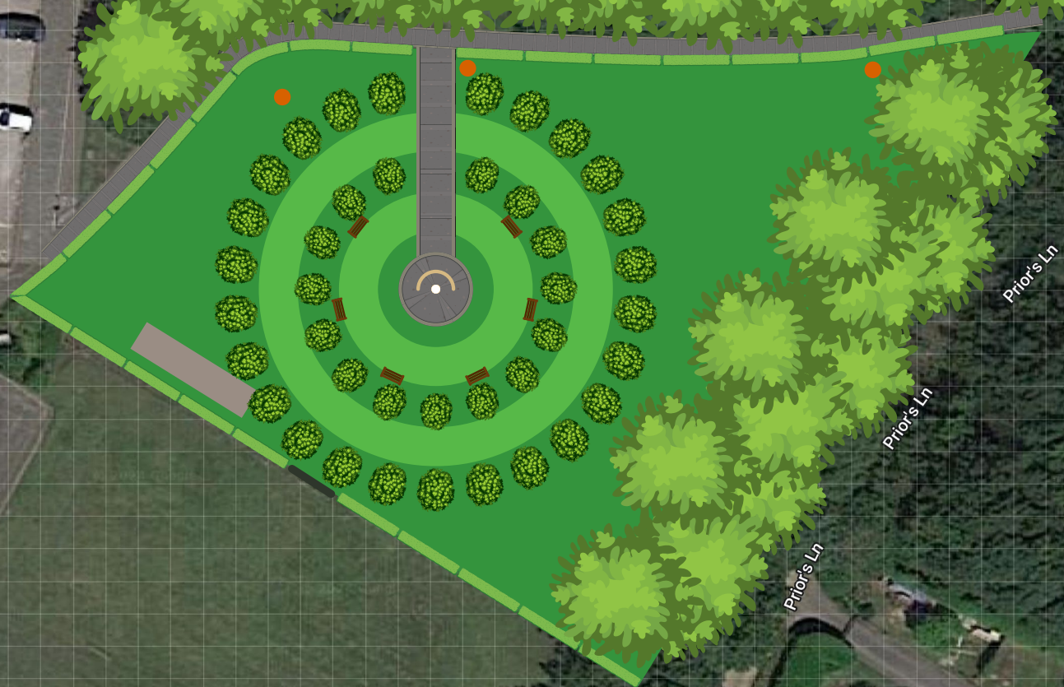
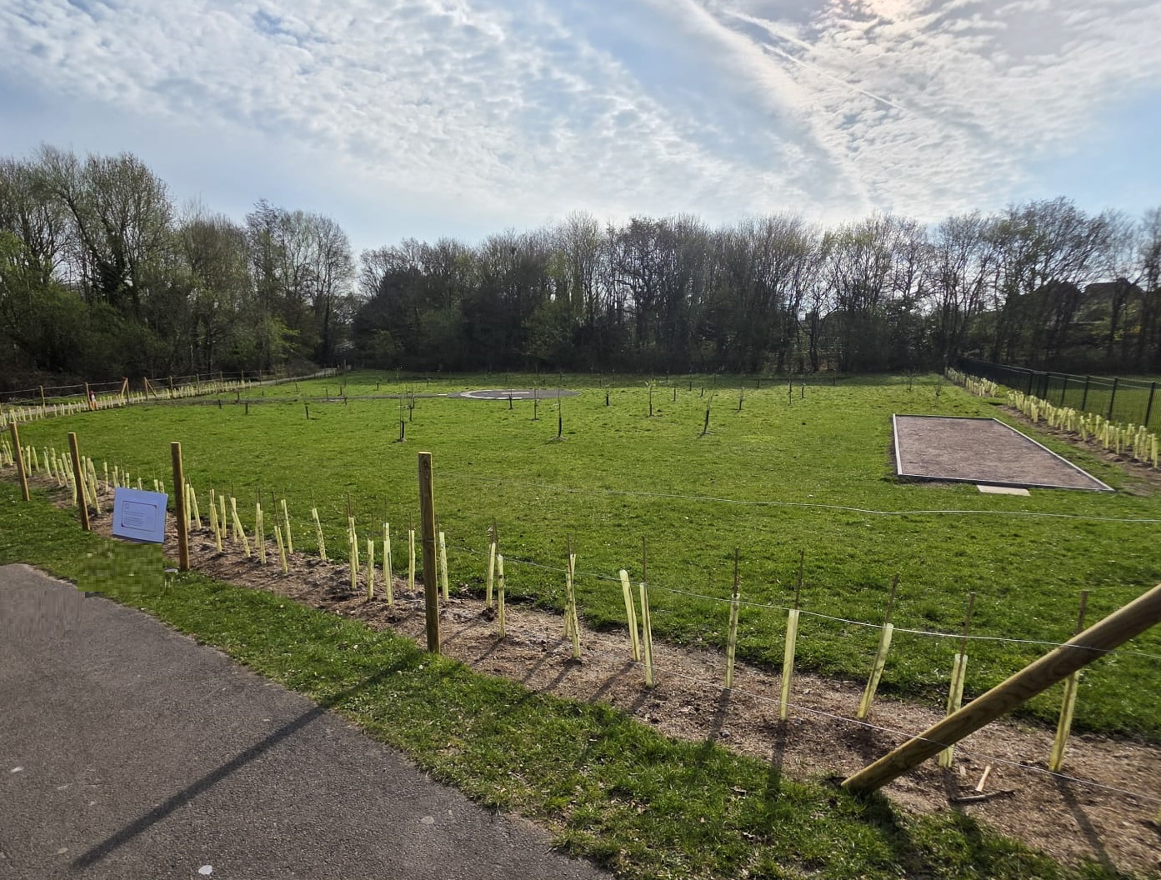
What’s next??
But we are not done yet:
Sow the wildflower seed in the designated areas.
Bench purchase from tree sponsor scheme.
Installing the sites own water source.
Making sure the site is maintained both professionally and by the schools.
Monitoring the biodiversity of the site to measure the benefits.
Frogmore Community Orchard – Finish
Date April 2025

Slide 23

Refreshments

Slide 24
Discussion and Feedback
Things to think about:
  Is this type of meeting useful?
  How often would you like to see Community Climate Forum meetings?
  Are you interested in an informal Climate Cafe?
  Are you interested in becoming Certified Carbon Literate?
  We would love to hear from you! Please let us know if you would like to give a talk at the next meeting

Slide 25

Thank you for coming!
Have a safe and low carbon journey home!

