Slide 1
Community Climate Forum
7th July 2025

Slide 2
Welcome!
Welcome
Impact Hart
YTC Update
Refreshments
Round table discussion
To our first Community Climate Forum

Slide 3
Community climate forum
7 July 2025

Slide 4
Community grants
Award of climate community grants to:
      Hook Halls Charitable Association (solar panels on Elizabeth Hall)
      Winchfield Village Hall (solar panel installation)
      Fleet Repair Cafe (phase 2, cafe expansion)
      Additional funding to:
      Hart Voluntary Action (eco-hub in Hart Shopping Centre)
    2025/26 grants will be open for applications soon.

Slide 5
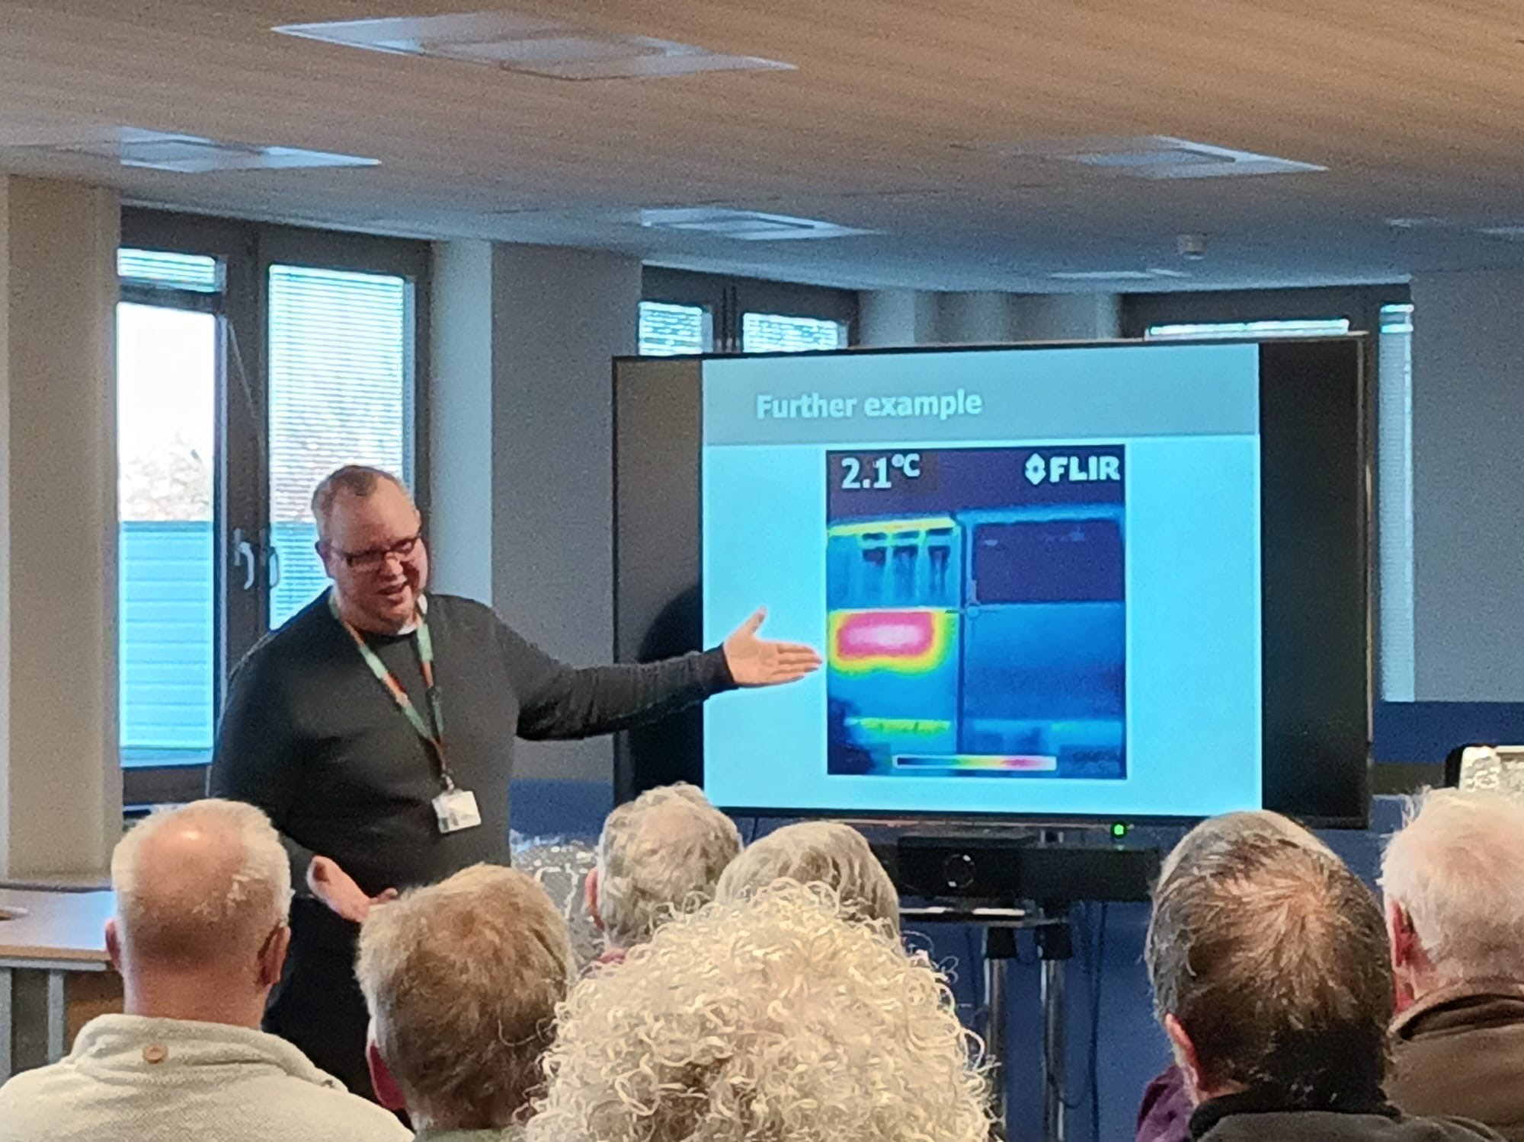
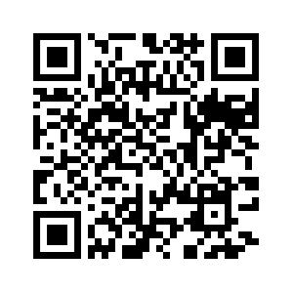
Thermal imaging scheme
136 properties surveyed
24 volunteers
426 volunteering hours altogether
Scan here for more information or visit www.impacthart.co.uk

Slide 6
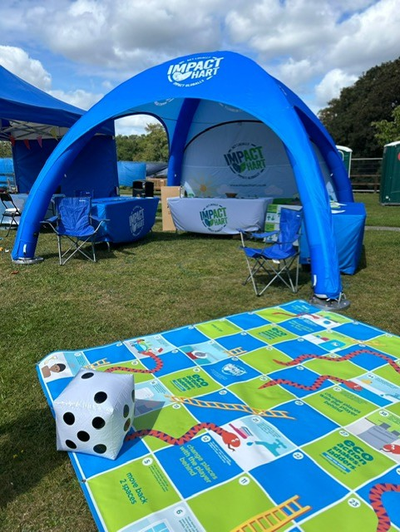
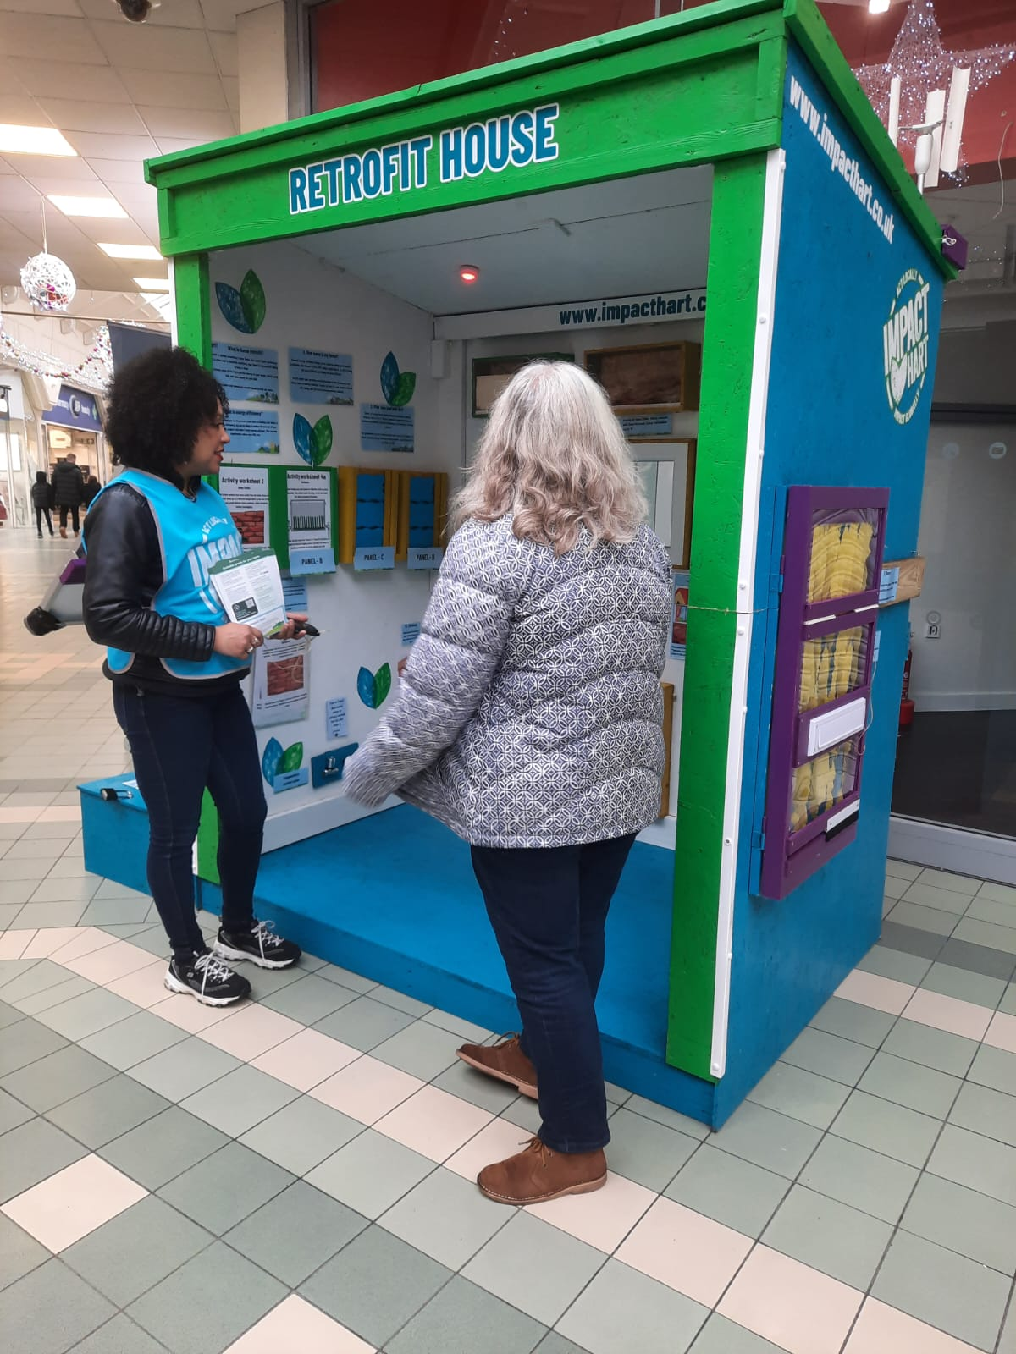
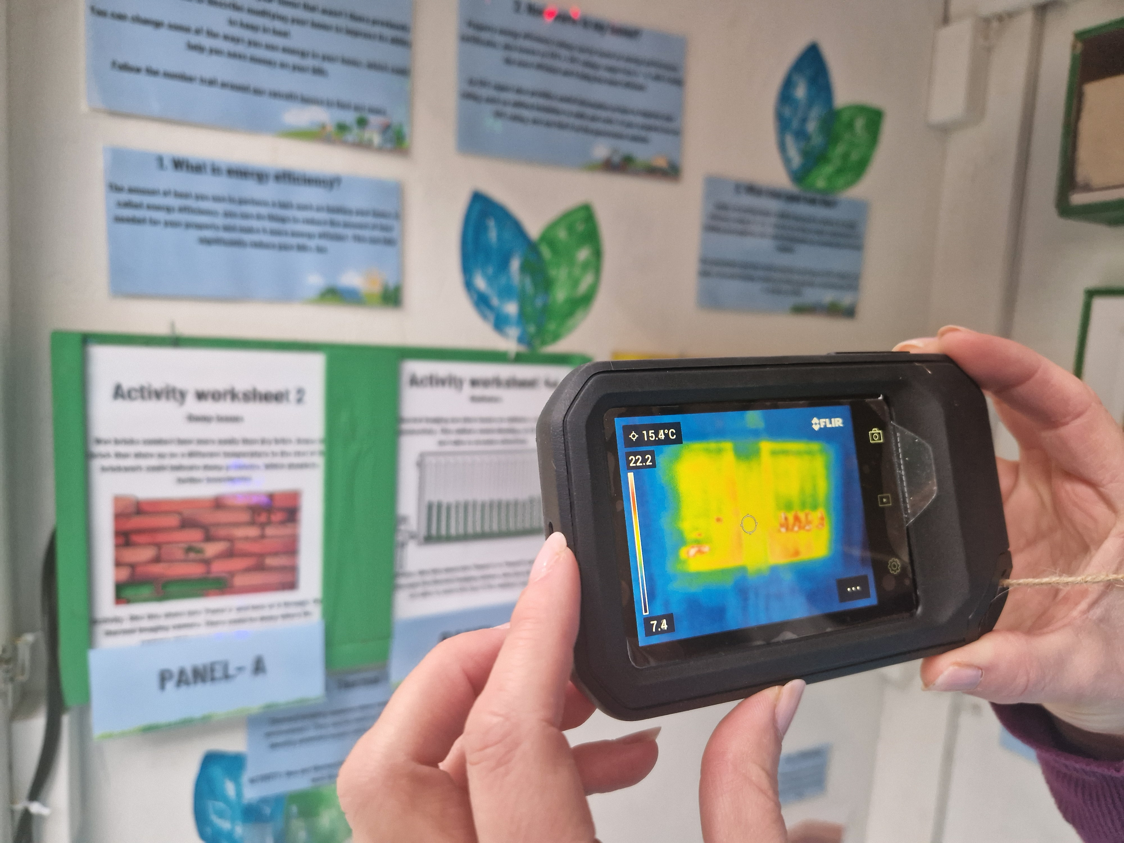
Volunteer?
Would you be interested in volunteering for Impact Hart?

Slide 7
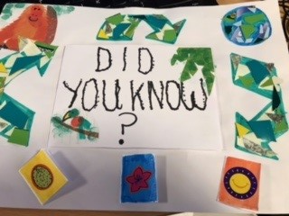
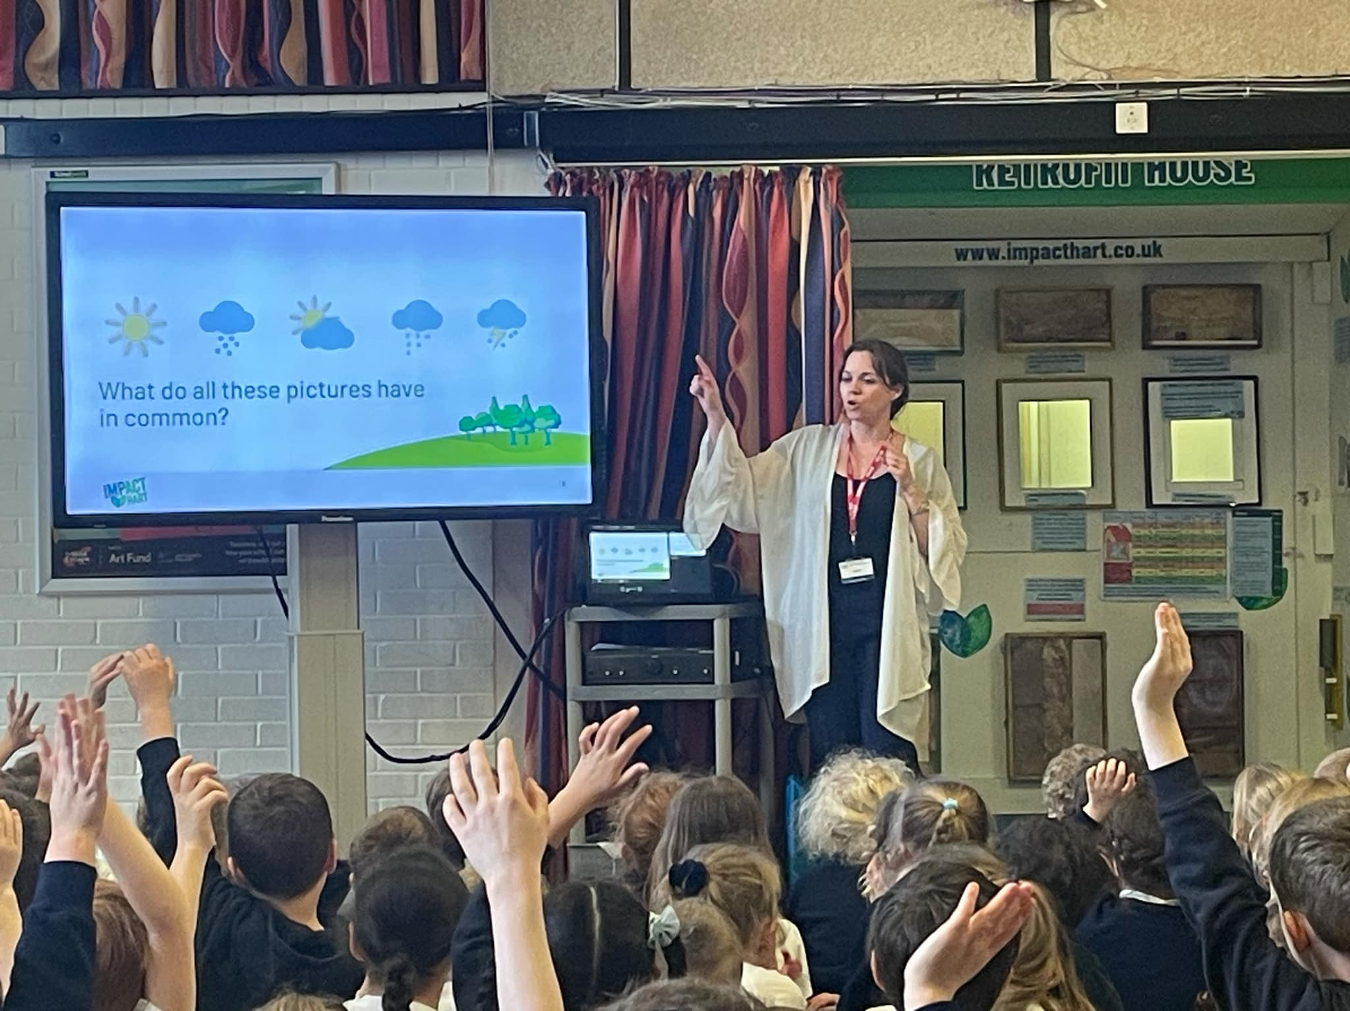
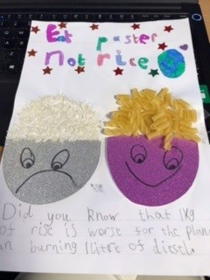

School engagement

Slide 8

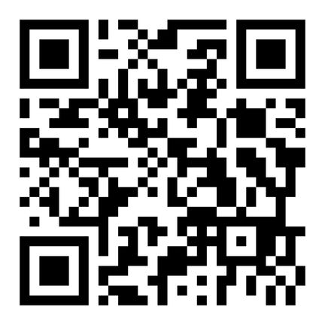
Home retrofit grants
Scan here for more information
Notes:
ECO4 Flex focuses on supporting low-income and vulnerable, fuel-poor households through installation of insulation and heating measures specifically for households with a current EPC rating of E ,F or G. It also offers those living with certain medical conditions the chance to apply through GP referral. Residents with a household income less than £31,000, may also be eligible.
InstaGroup will be the managing agent for this scheme in Hart and with over 20 years of experience in helping people insulate their homes, are well placed to guide residents through the process of accessing funding.

Slide 9


The Environment Centre
Notes:
My Home Made Better is a FREE energy advice service covering Hart. It provides tailored, impartial guidance to homeowners on improving energy efficiency, reducing costs and future-proofing their homes. Run by expert advisers at the Environment Centre (tEC), the service offers personalised advice based on each homeowner's unique circumstances. Recommendations are provided via step-by-step plans, ensuring confidence and a pressure-free approach. The initiative goes beyond phone support, fostering a regional effort to inspire and connect communities.
To find out more call 0800 804 8601 or email myhome@environmentcentre.com.

Slide 10
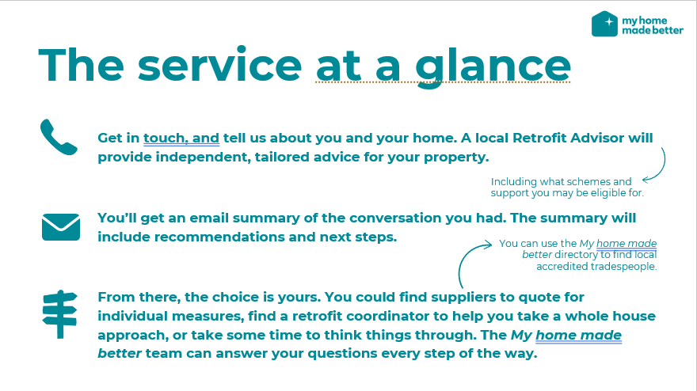

Slide 11


Slide 12

Local government re-organisation

Slide 13
Visit the Impact Hart website
www.impacthart.co.uk

Slide 14

Refreshments

Slide 15

Climate Priorities Summary
Net Zero by 2030
Council decisions meet climate change criteria
Reduce single use plastics
Support biodiversity and continue to plant trees
Improve energy efficiency of our buildings

Slide 16
YTC Update
Moving forward with replacing windows in our office and at the Tythings
Upgrading tennis court floodlights to LEDs
Upgrading streetlights at the Darby Green Centre to LEDs
Public toilets upgrade- sensor flushes and taps, PIR sensors for LED lights, as vandal proof as possible
Utilities- switching to vegan gas supplier and 100% renewable electricity (our current provider is too), we will save approx. 30% plus feed in tariff for solar panels
Solar Panel Data

Slide 17
Office Solar Panels

Slide 18
Office Solar Panels

Slide 19
Office Solar Panels

Slide 20
Tythings Solar Panels

Slide 21
Tythings Solar Panels

Slide 22
Tythings Solar Panels

Slide 23

Thank you for listening!
Any questions?

Slide 24
Round Table Discussion
Does anyone:
  Have any questions?
  Have any projects they would like to share?
  Need volunteers or help with carrying out a climate change project?
  Have anything else they would like to share?

Slide 25

Thank you for coming!
Have a safe and low carbon journey home!

