Slide 1
Community climate forum
7 July 2025

Slide 2
Community grants
Award of climate community grants to:
      Hook Halls Charitable Association (solar panels on Elizabeth Hall)
      Winchfield Village Hall (solar panel installation)
      Fleet Repair Cafe (phase 2, cafe expansion)
      Additional funding to:
      Hart Voluntary Action (eco-hub in Hart Shopping Centre)
    2025/26 grants will be open for applications soon.

Slide 3
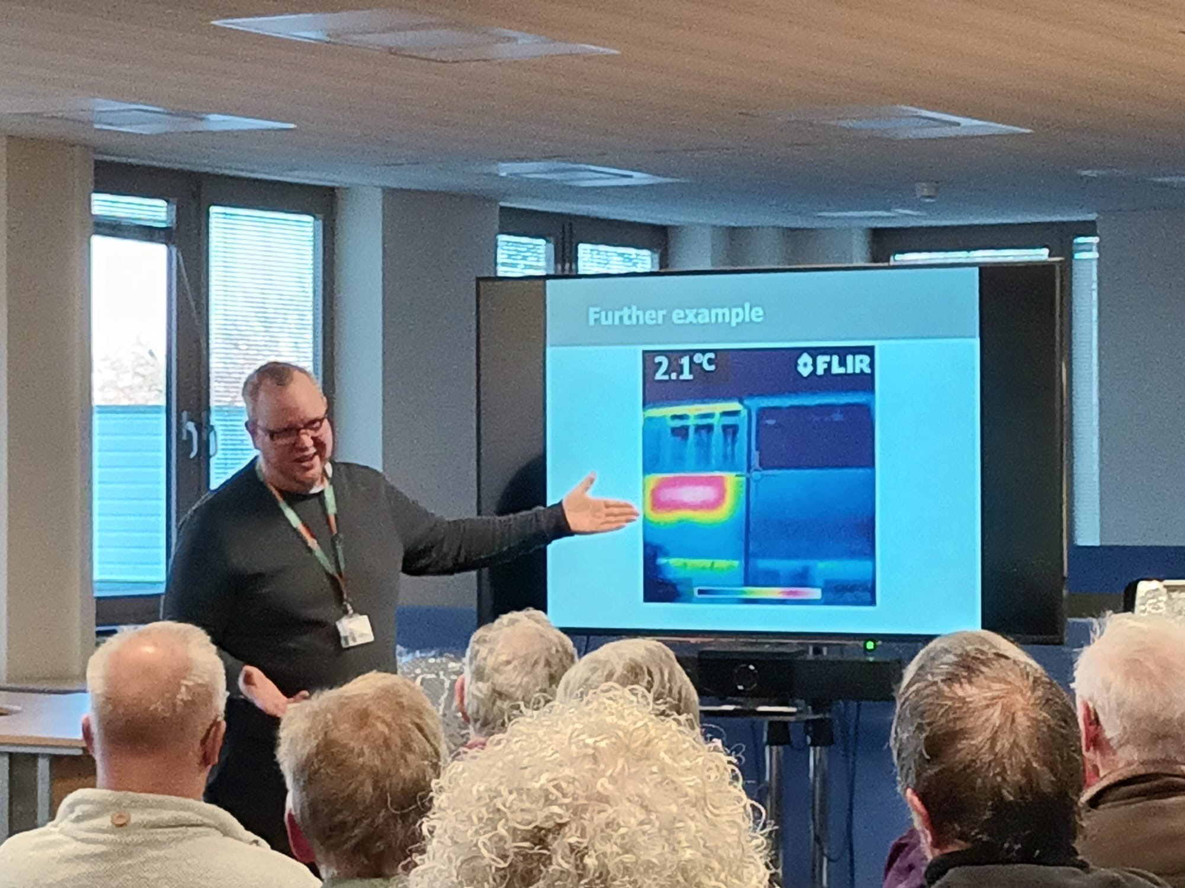
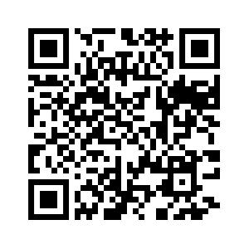
Thermal imaging scheme
136 properties surveyed
24 volunteers
426 volunteering hours altogether
Scan here for more information or visit www.impacthart.co.uk

Slide 4
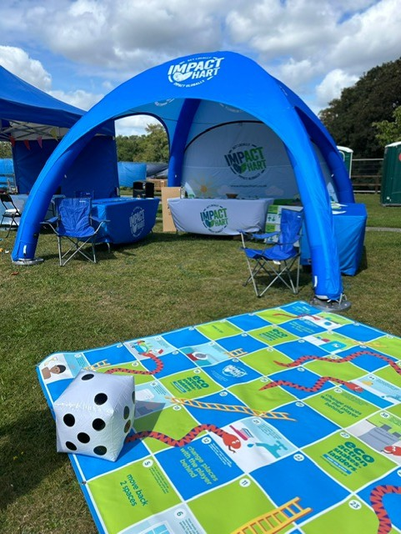
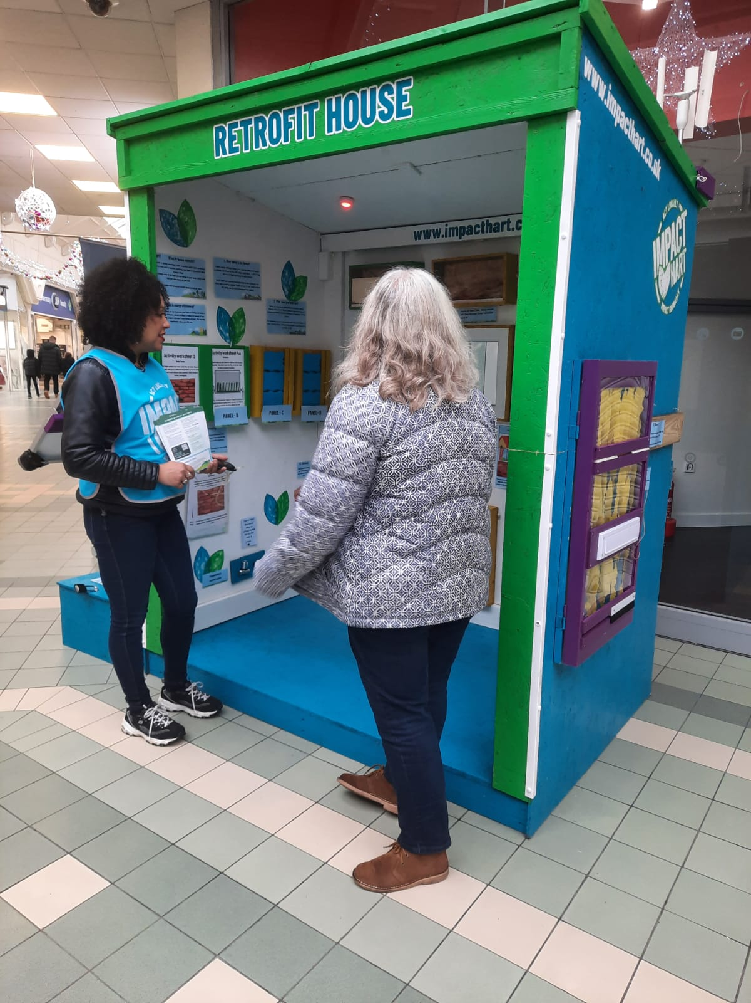
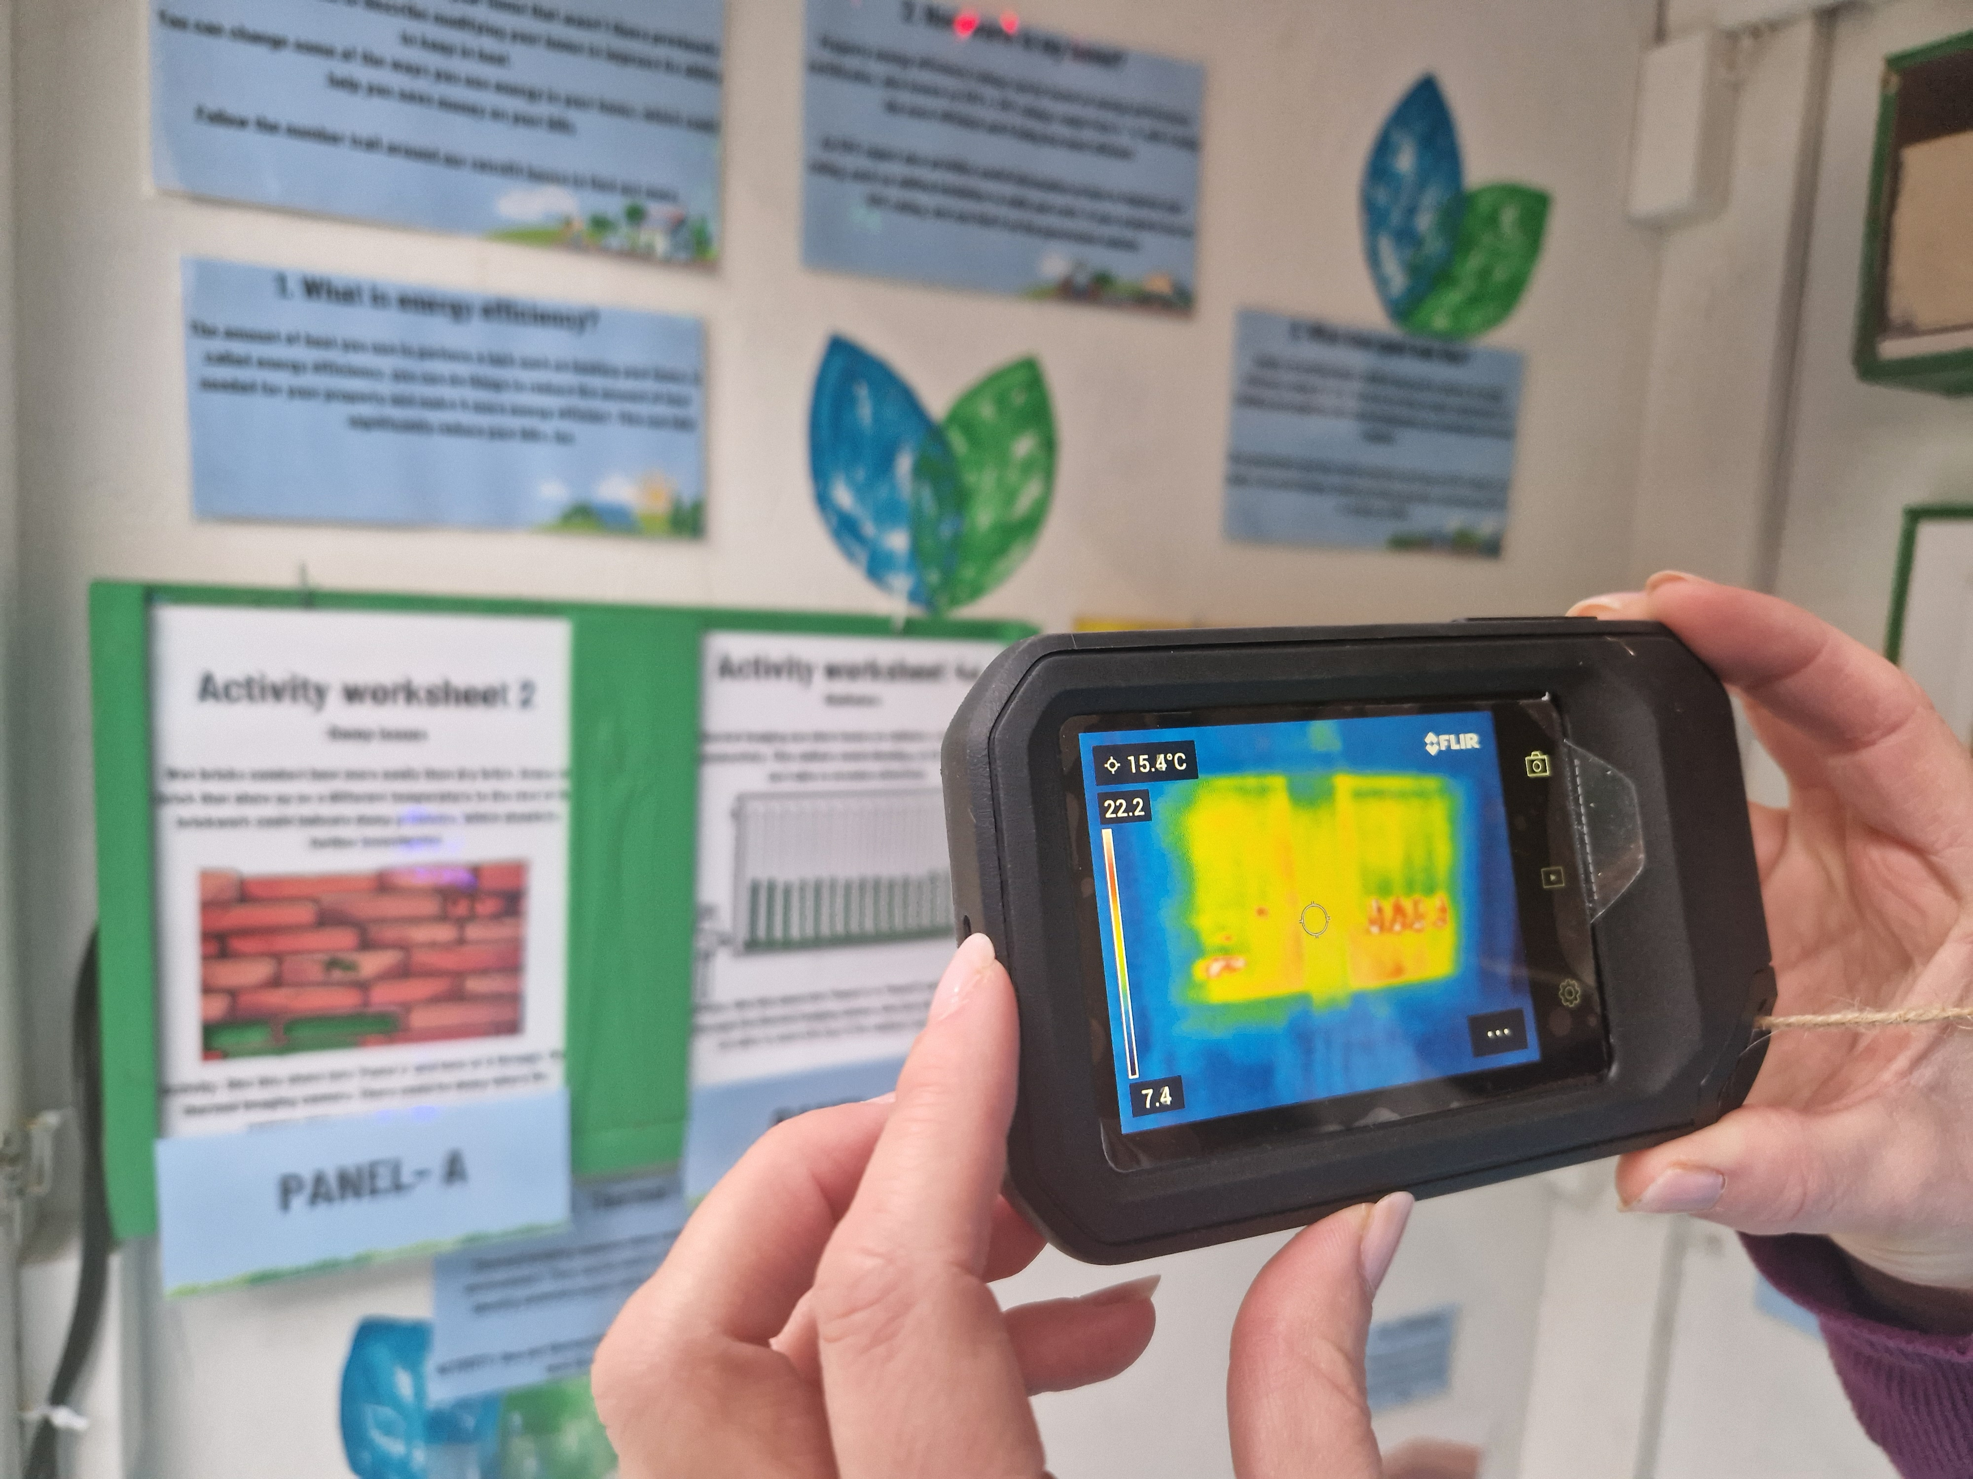
Volunteer?
Would you be interested in volunteering for Impact Hart?

Slide 5
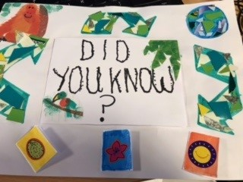
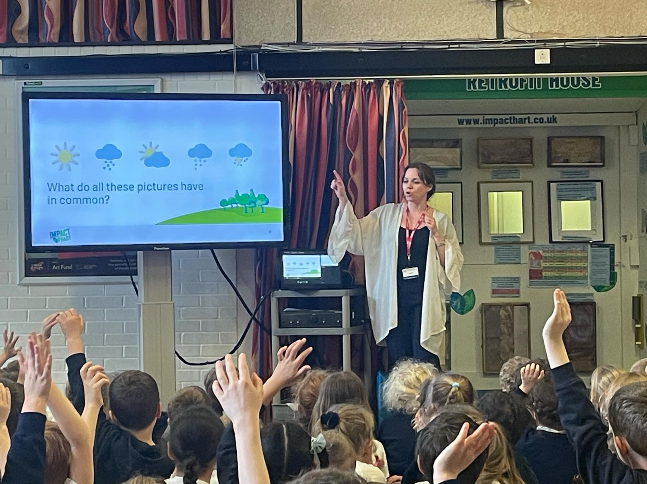
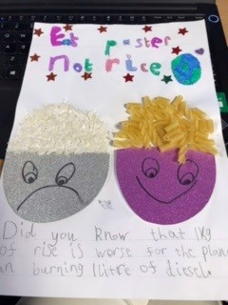

School engagement

Slide 6

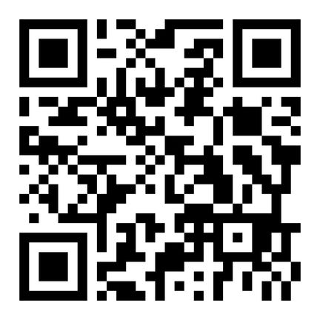
Home retrofit grants
Scan here for more information
Notes:
ECO4 Flex focuses on supporting low-income and vulnerable, fuel-poor households through installation of insulation and heating measures specifically for households with a current EPC rating of E ,F or G. It also offers those living with certain medical conditions the chance to apply through GP referral. Residents with a household income less than £31,000, may also be eligible.
InstaGroup will be the managing agent for this scheme in Hart and with over 20 years of experience in helping people insulate their homes, are well placed to guide residents through the process of accessing funding.

Slide 7


The Environment Centre
Notes:
My Home Made Better is a FREE energy advice service covering Hart. It provides tailored, impartial guidance to homeowners on improving energy efficiency, reducing costs and future-proofing their homes. Run by expert advisers at the Environment Centre (tEC), the service offers personalised advice based on each homeowner's unique circumstances. Recommendations are provided via step-by-step plans, ensuring confidence and a pressure-free approach. The initiative goes beyond phone support, fostering a regional effort to inspire and connect communities.
To find out more call 0800 804 8601 or email myhome@environmentcentre.com.

Slide 8
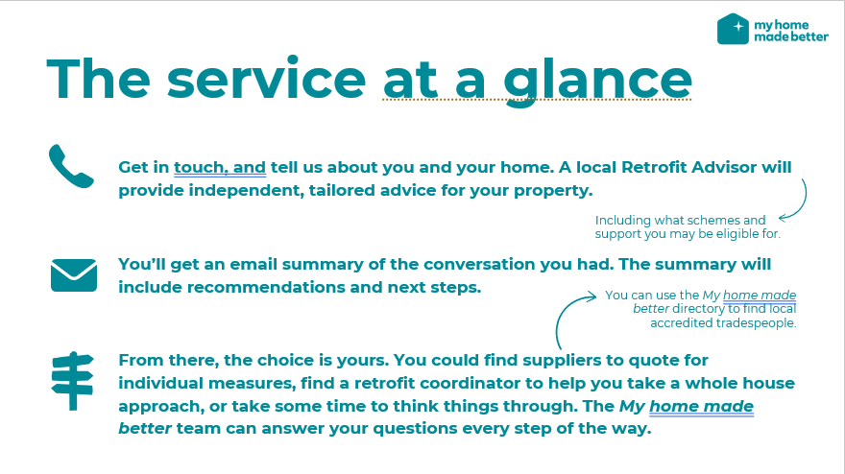

Slide 9


Slide 10

Local government re-organisation

Slide 11
Visit the Impact Hart website
www.impacthart.co.uk

